Slide 1
Infection prevention and control (IPC)
In community pharmacy
Emma Mills
Head of IPC

Slide 2
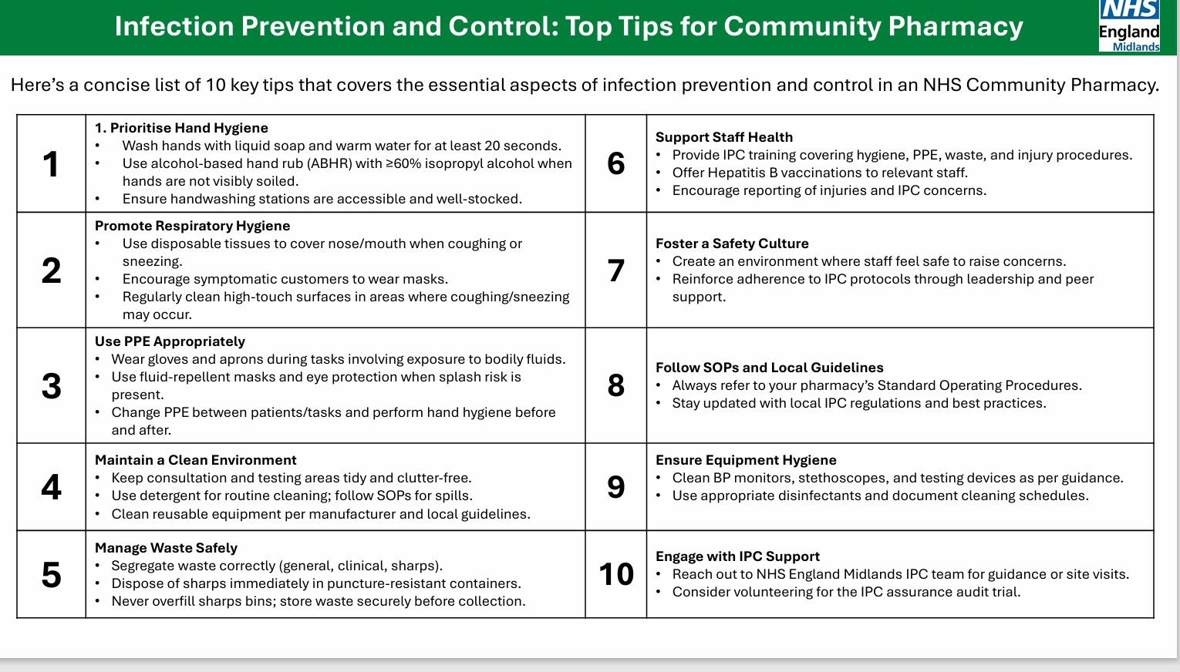
Top tips

Slide 3
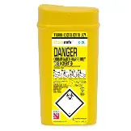
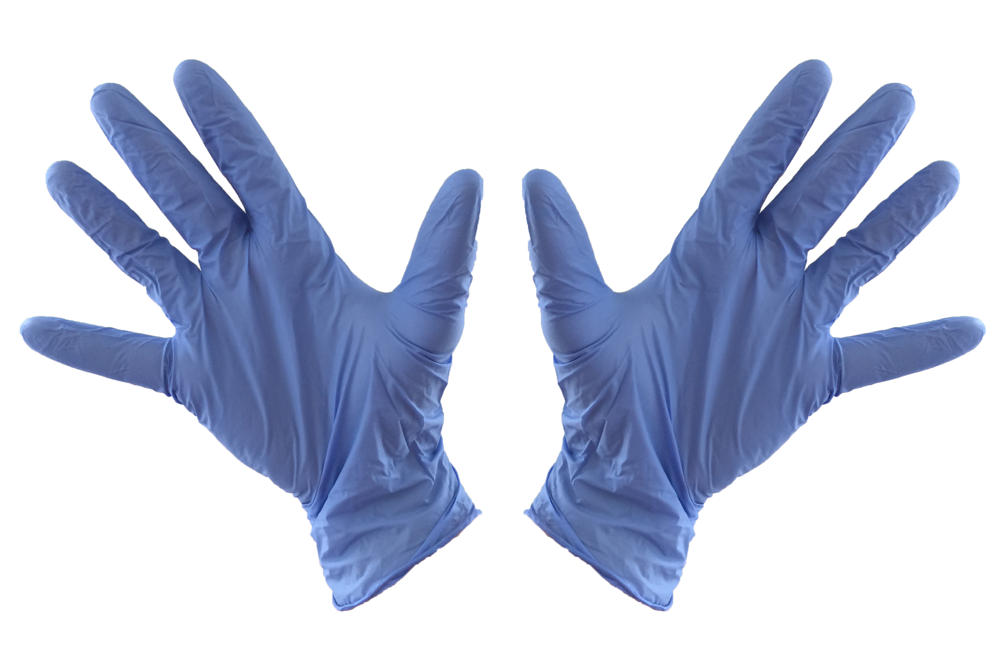
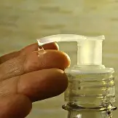
What else?
Make sure you have adequate supplies of materials for:
hand decontamination (soap, alcohol gel, handtowels)
safe sharps disposal
PPE (gloves, aprons, masks)
Maintain condition of premises and if you are refurbishing:
avoid carpet and fabric covered seating
ensure surfaces are non-permeable, wipeable and can be easily cleaned
avoid clutter
Have a cleaning rota and a SOP and:
clean as soon as possible after you have seen an infectious person (coughing, sneezing or worse)
clean high touch points regularly
detergent should do the job
take care when cleaning vomit or blood, staff should have access to spillage kits and use gloves and aprons when carrying out high risk cleaning tasks. Use a chlorine solution (household bleach or actichlor e.g.)

Slide 4
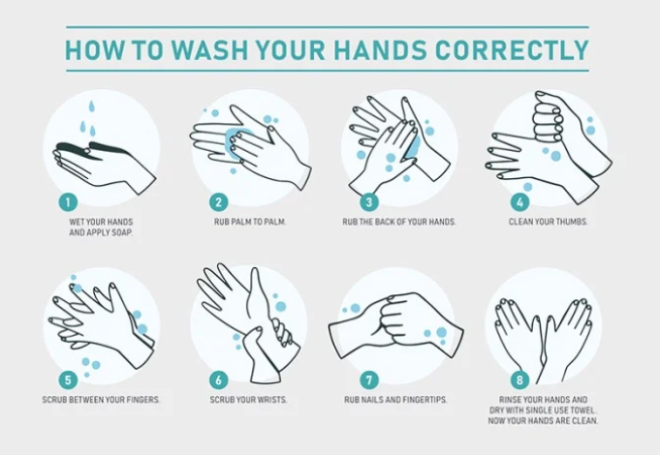

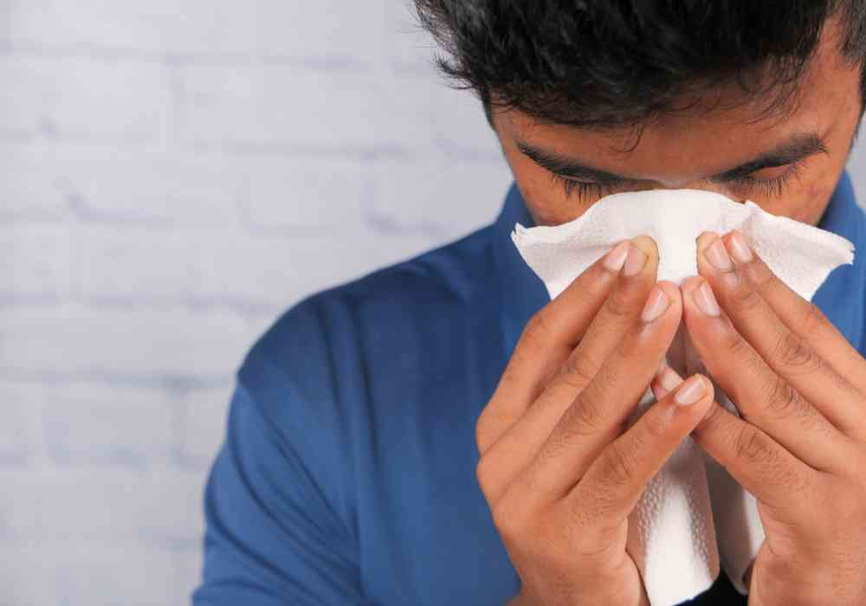
What else?
Handwashing
ensure handwashing sinks are available with warm running water in clinical areas, think about the dispensary and consultation rooms and consider installing clinical handwash basins.
paper towels for hand drying should be disposed of in a lidded, pedal operated bin
all staff should have training in hand hygiene
display handwashing guide
wash hands before and after clinical interventions
can use alcohol gel in between vaccinations, but also need to handwash
hand cream or lotion can support good hand hygiene practice
bare below the elbows

Slide 5
What else?
Professional appearance
Have a policy around needlestick injury
Recognising communicable diseases and referring to GP
Think about patient placement
Staff should understand cough etiquette and catch it, kill it, bin it. Hand hygiene is important here too

Slide 6
Contacts
B8c
Head of IPC
WTE 1.0
Emma Mills
B8b
Health Protection nurse
Suffolk
WTE 0.6
Tracey Sharpe
B8a
Senior IPC nurse
WTE 1.0
Norfolk
Abbie Colvin
B8a
Senior IPC nurse
WTE 1.0
Suffolk
Marje Naz
B8b
Health Protection nurse
Norfolk
WTE 1.0 (0.5 ICB)
Rowan Slowther

Slide 7
Contacts
Name | Email | Telephone (if available)
Emma Mills | emma.mills67@nhs.net | 07855111584
Rowan Slowther | rowan.slowther@nhs.net | 07827895844
Tracey Sharpe | tracey.sharpe4@nhs.net | 07971594768
Abbie Colvin | abigail.colvin3@nhs.net | 01473 770251
Marje Naz | marjorie.naz1@nhs.net | 01206 918671

Slide 8
References
10-Top-Tips-for-IPC-FINAL-December-2025.pdf
NHS England » National infection prevention and control
Overview | Healthcare-associated infections: prevention and control in primary and community care | Guidance | NICE
Notifiable diseases and how to report them - GOV.UK
How to wash your hands – NHS
UKHSA handwashing advice
Do’s and don'ts of clinical handwash basins - Infection Prevention Control

