Slide 1


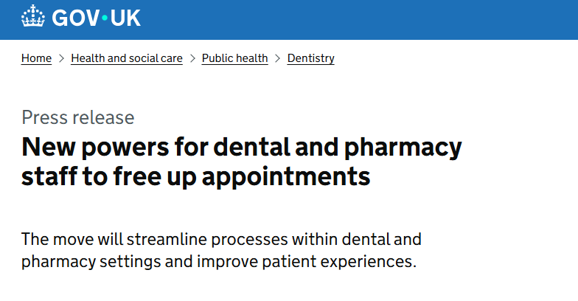



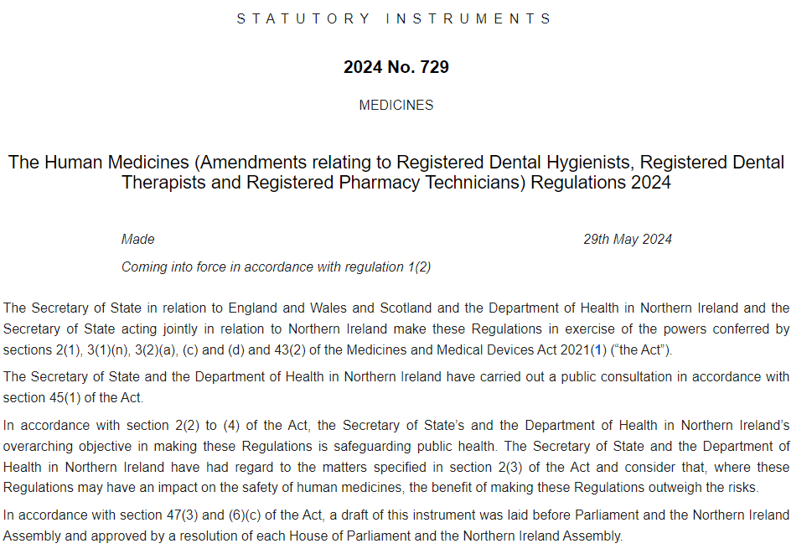



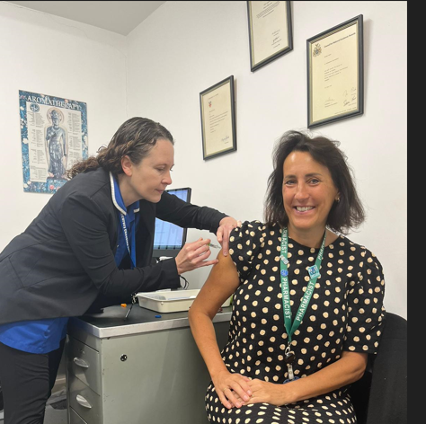

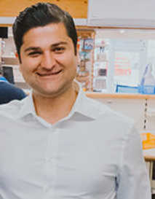
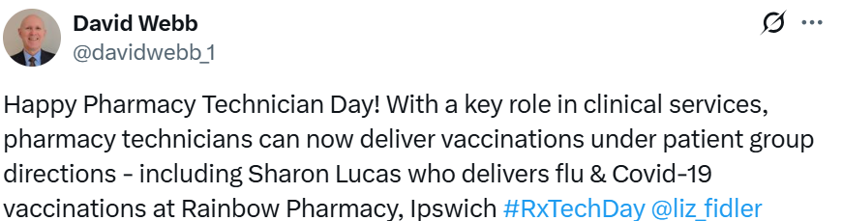


The Expanding Role of Registered Pharmacy Technicians, are you Maximising Your Workforce?
Dearden C¹ Lucas S² Cavanagh S³
1. NHS Staffordshire and Stoke-on-Trent Integrated Care Board 2. Rainbow Pharmacy 3. NHS England, East of England
INTRODUCTION
📢 The Human Medicines Regulations 2012 (1) were amended in June 2024 (2). They now include, in Schedule 16, Part 4, “registered pharmacy technicians” as a class of individual by whom supplies may be made under Patient Group Directions.
This legislative change is a key enabler, maximising the skills and expertise within the pharmacy workforce.
We showcase Rainbow Pharmacy 🌈 in Ipswich, who began using their registered pharmacy technician
workforce, during autumn/winter 2024/25 for the Flu and COVID-19 seasonal vaccination programmes.
By embracing this change to the legal mechanism, 🌈 Rainbow pharmacy have maximised their workforce and increased their capacity to vaccinate the people in their community.
AIM
METHOD
Demonstrate the benefits of using the pharmacy workforce more resourcefully by using registered pharmacy technicians to vaccinate under PGDs and the difference this can make when delivering a clinical service.
Provide insight and shared learning to pharmacy teams by sharing a best practice example via local, regional and national communication and engagement.
To showcase from an operational perspective how to use the pharmacy workforce skills and expertise more fully to provide a more accessible and convenient service.
Consider how realising the potential of the registered pharmacy technician workforce, will support the future ambitions of the NHS.
Rainbow pharmacy decided to take advantage of the 2024 legislative change to transform their delivery approach to the autumn/winter 2024/25 Flu and COVID-19 seasonal vaccination programmes.
Vaccination events were recorded by total number, also vaccinator and compared with the
previous year’s activity.
Between Sep 2024 and 31 Jan 2025 🌈 Rainbow pharmacy delivered 1,858 COVID-19, 1,751 Flu and 133 RSV vaccines.
Ashwin Bhatt, superintendent pharmacist, said, “This change to the legislation means we can now utilise our clinical workforce fully and offer a more convenient and accessible service to our community.”
25%
For the first time 25% of the vaccinations have been delivered by their Registered Pharmacy Technician
Local, regional and national communication and engagement showcased this model on Pharmacy Technician Day with Chief Pharmaceutical Officer for England David Webb
posting on social media.
Figure 1 Sharon Lucas and Sarah Cavanagh
Benefits
DISCUSSION AND CONCLUSION
Sharon now plays a more active role in direct patient care, which has helped free up the pharmacist’s time to focus on delivering enhanced clinical services. This shift has improved overall workflow efficiency and enabled the wider team to better utilise their skills and expertise, ultimately allowing patients to access more clinical services in a timely manner. Sharon’s role as a pharmacy technician at 🌈 Rainbow Pharmacy has continued to grow, contributing to her increased job satisfaction and supporting her career development.
This poster provides an example of how registered pharmacy technicians can benefit pharmacy teams and the population by utilising their skills and expertise.
🌈 Rainbow pharmacy was able to offer more vaccinations (by cohort) than previous years, enabling access to vaccinations to be at a time and place convenient to the community, in a setting they know and trust.
1
Human Medicines Regulations 2012 SCHEDULE 16 [Internet]. Legislation.gov.uk. 2012 [cited 2025 Mar 7]. Available from: https://www.legislation.gov.uk/uksi/2012/1916/schedule/16
Human Medicines (Amendments relating to Registered Dental Hygienists, Registered Dental Therapists and Registered Pharmacy Technicians) Regulations 2024 [Internet]. Legislation.gov.uk. 2024 [cited 2025 Mar 7]. Available from: https://www.legislation.gov.uk/uksi/2024/729/contents/made
Sharon Lucas registered pharmacy technician added “she felt proud to deliver this clinical service”
REFERENCES
“people have been really enthusiastic about their vaccines this year, they like being vaccinated by someone they know and trust and speak to regularly to makes such a difference”

